Slide 1
A
Android
Version
HISTORY

Slide 2
INDEX / STEP
1
Explain of android version history
2
3
Chart of Android
Version
Explain of version

Slide 3
WHAT
IS
Android Version

Slide 4
Android Version
The version history of the Android mobile operating system began with the public release of the Android beta on November 5, 2007. The first commercial version, Android 1.0, was released on September 23, 2008.

Slide 5
Version Name
Froyo
Donut
Beta
6
4
Eclair
Alpha
2
Cupcake
5
1
3

Slide 6
Version Name
Honeycomb
Jelly Bean
Lollipop
Ice Cream
sandwich
KitKat
12
Gingerbred
10
8
11
7
9

Slide 7
Version Name
Android P
Beta Version
Android Q
Nougat
Marshmallow
Oreo
16
Future Version
14
Latest Version
17
13
15

Slide 8
The
Chart of
Version

Slide 9
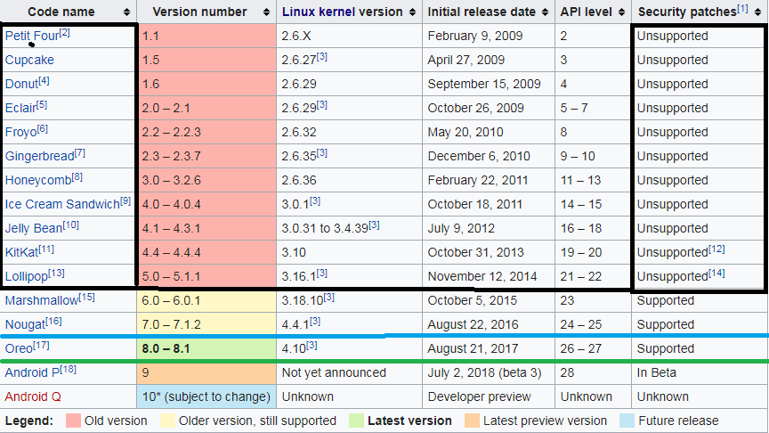

Slide 10

Cupcake

Slide 11
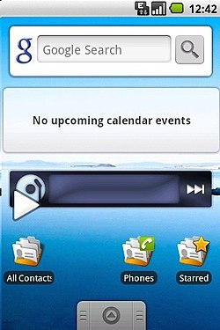
Android Cupcake
Developer Google.
Release to April 27, 2009.
Version (1.5)

Slide 12

Donut

Slide 13
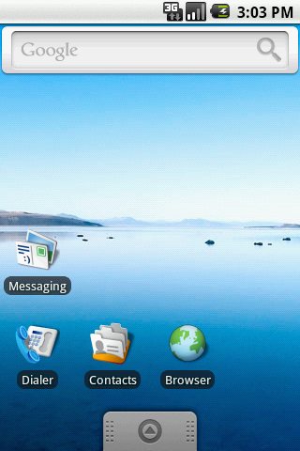
Android Donut.
Developer ;- Google.
Initial release ;- September 15, 2009,
Version ;- (1.6)

Slide 14
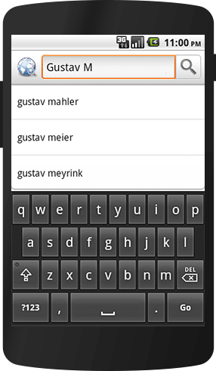
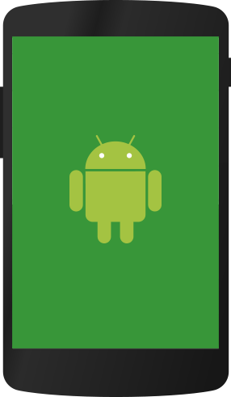

Features
Quick Search Box
Google play service
Large Screen size

Slide 15
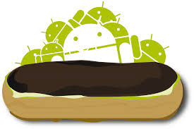
Eclair

Slide 16
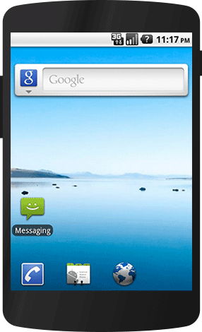
Android Eclair.
Developer ;- Google.
Initial release ;- October 26, 2009;
Version ;- (2.0 – 2.1)

Slide 17
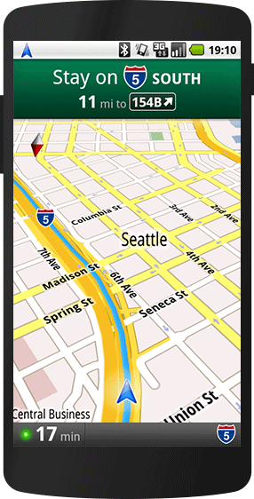
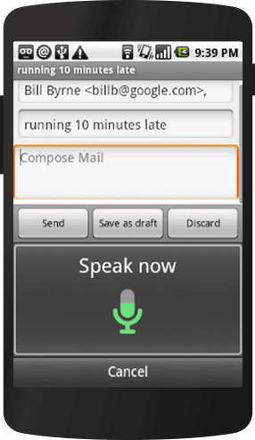
Features
Home Screen Customizations
Google Map Navigation
Speech-to-text

Slide 18
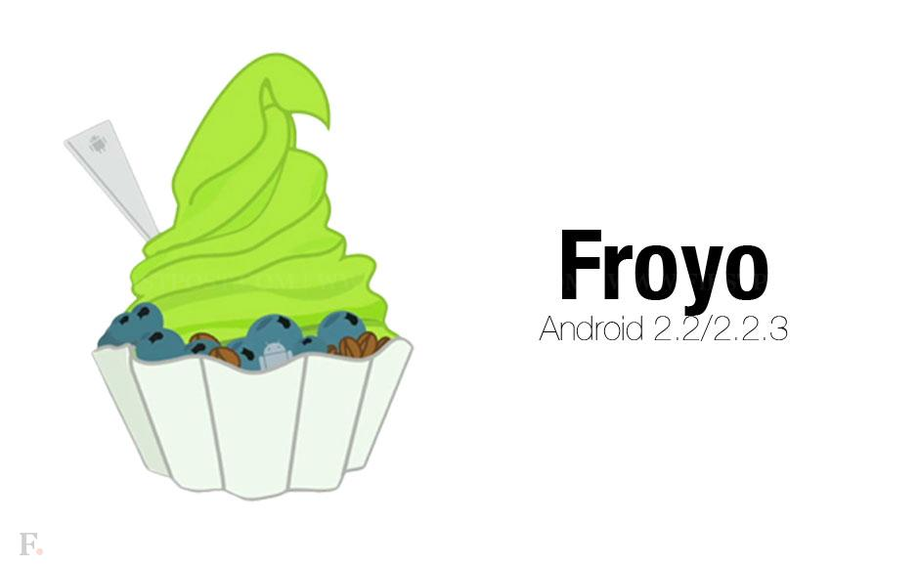

Slide 19
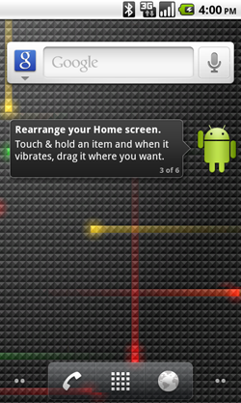
Android Froyo
Developer ;- Google.
Initial release ;- May 20, 2010;
Version ;- ( 2.2 – 2.2.3 )

Slide 20
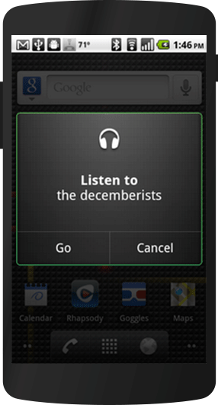


Features
Performance
Portable Hotspot
Voice Action

Slide 21
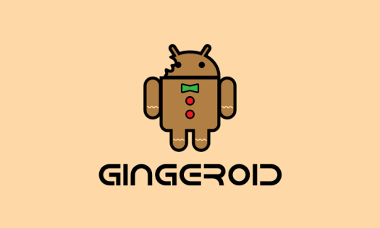
Gingerbread

Slide 22
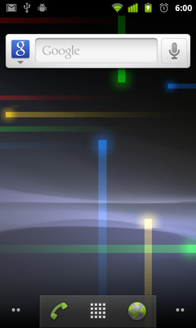
Android Gingerbread
Developer ;- Google
release to ;- December 6, 2010;
Version ;- 2.3 – 2.3.7

Slide 23
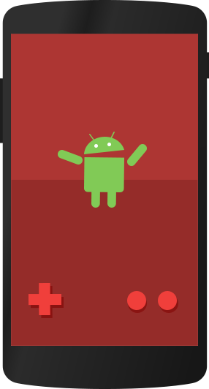

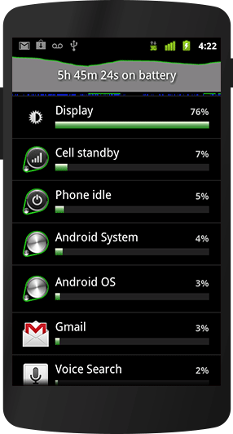
Features
Gaming APIS
Wifi
Battery Management

Slide 24

Honeycomb

Slide 25
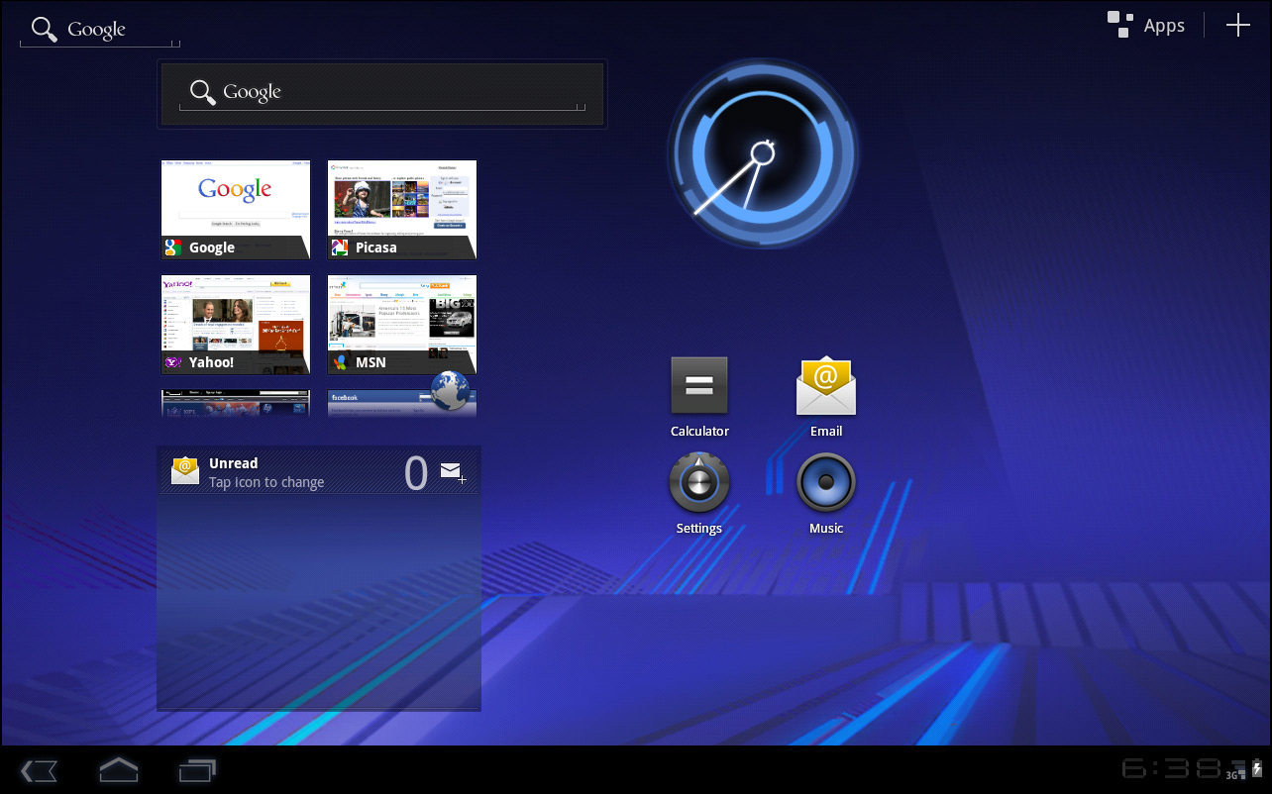
Honeycomb
Honeycomb version release in tablet/smart phone.
Developer ;- Google.
Release to ;- February 22, 2011; 7 years ago.
Version ;- (3.0 – 3.2.6)

Slide 26
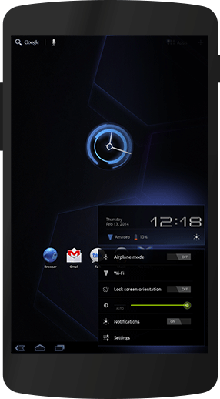

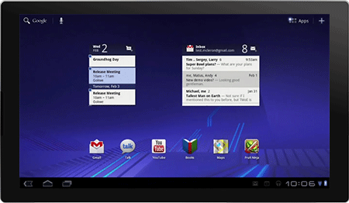
Features
Tablet-Friendly Design
System Bar
Quick setting

Slide 27
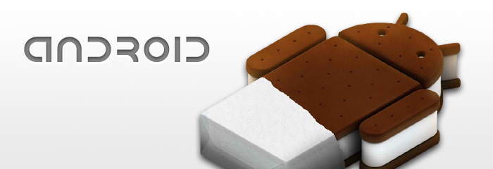
Ice Cream Sandwich

Slide 28
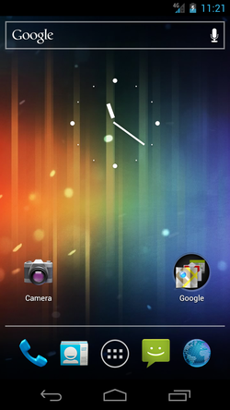
Android Ice Cream Sandwich
Developer ;- Google.
Release to ;- October 19, 2011; 6 years ago.
Version ;- (4.0 – 4.0.4)

Slide 29
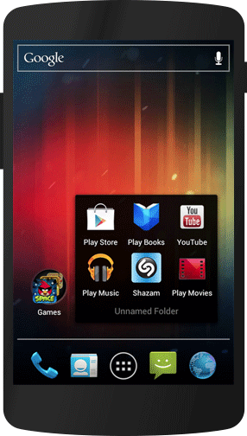
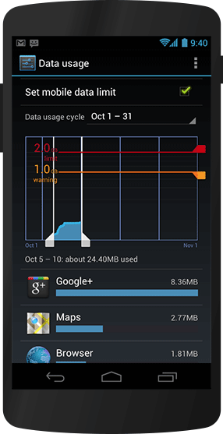
Features
Custom home screen
Data usage control

Slide 30

Jelly bean

Slide 31
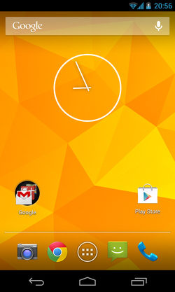
Android Jelly Bean
Developer ;- Google
Released ;- July 13, 2012;
Version ;- (4.1 – 4.3.1)

Slide 32
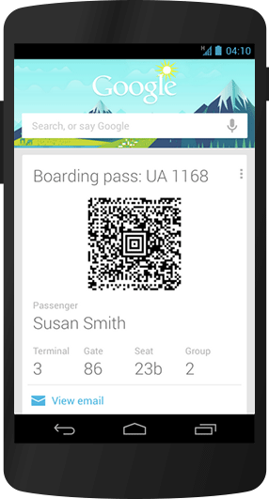
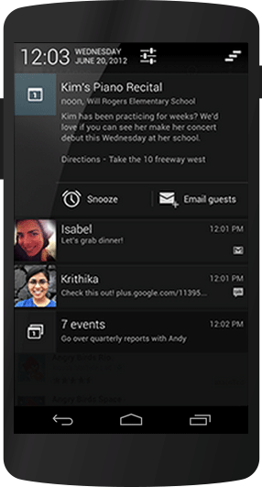
Features
Lock screen notification
Google Now

Slide 33


Slide 34
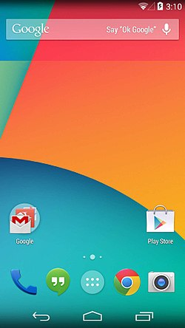
Android KitKat
Developer ;- Google.
Released ;- October 31, 2013;
Version ;- (4.4 – 4.4.4)

Slide 35
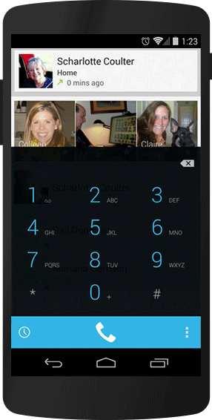
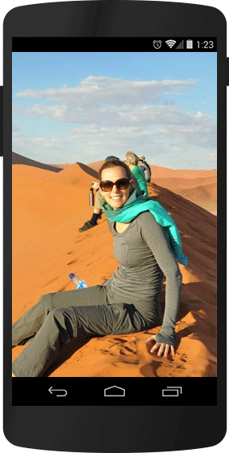

Features
Smart Dialler
Immersive Design
Voice OK Google

Slide 36


Slide 37
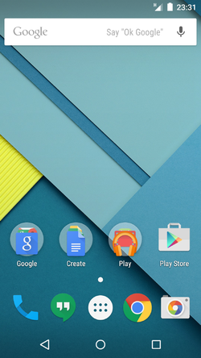
Android Lollipop
Developer ;- Google.
Released to ;- November 12, 2014;
Version ;- (5.0 – 5.1.1)

Slide 38
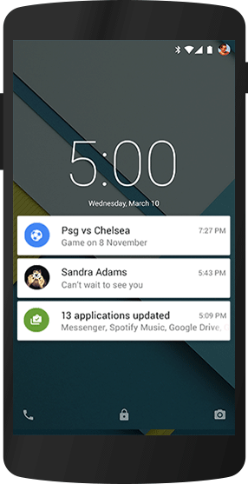
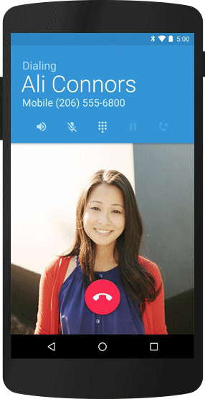

Features
Graphic Quality
Smart Dialler
Lock Screen notification

Slide 39

Marshmallow

Slide 40
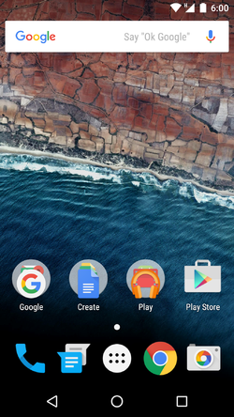
Android Marshmallow
Developer Google
Released to October 5, 2015; 2 years ago.
Version 6.0 – 6.0.1

Slide 41
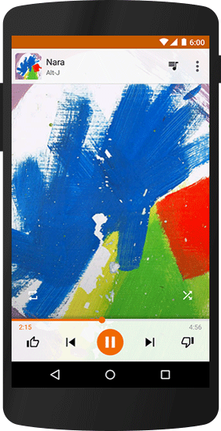
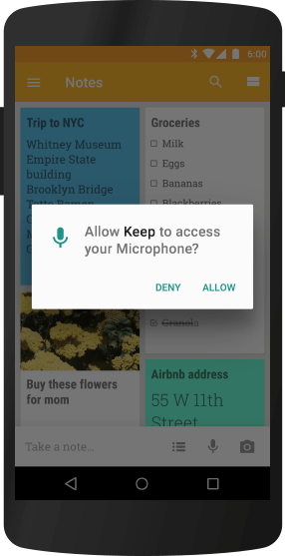

Features
Ask permission
Smart betray saver
Smart Sound

Slide 42

Nougat

Slide 43
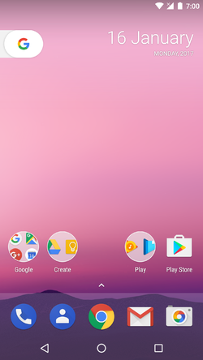
Android Nougat
Developer ;- Google
Released to ;- August 22, 2016;
Version ;- ( 7.0 – 7.1.2)

Slide 44
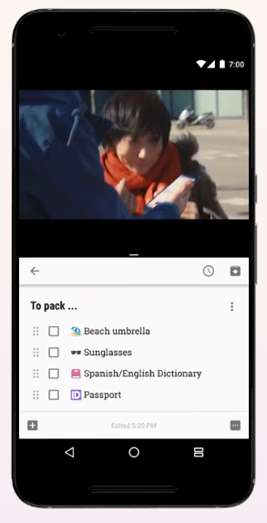
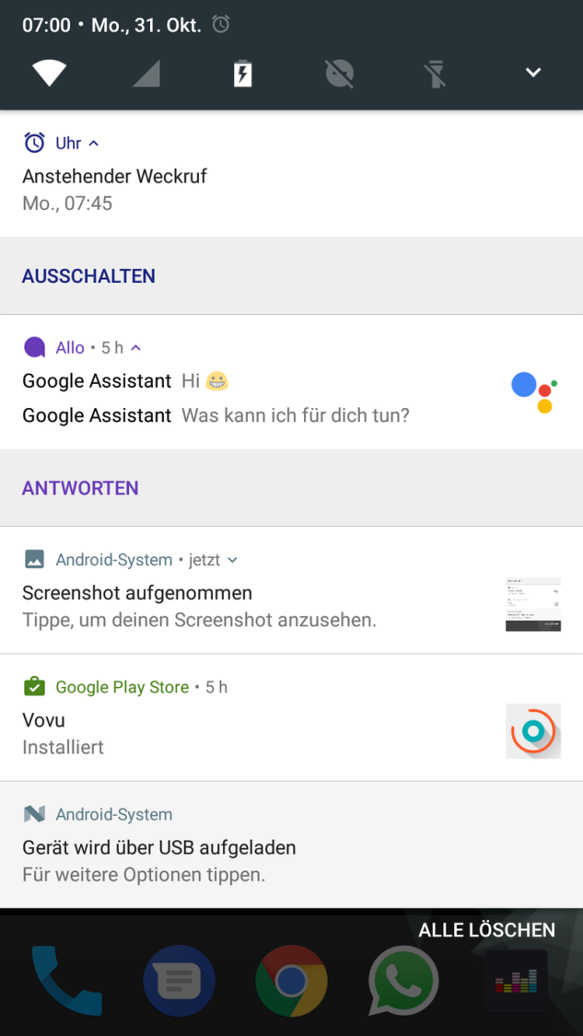

Features
Best gaming result
Use both application
Smart notification bar

Slide 45
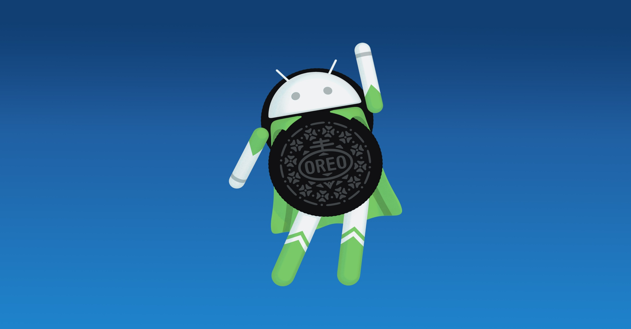
Oreo

Slide 46
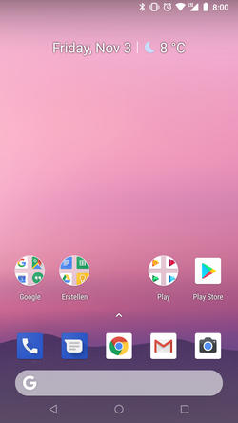
Android Oreo
Developer ;- Google
Released to ;- February 21, 2018;
Version ;- (8.0 – 8.1)

Slide 47
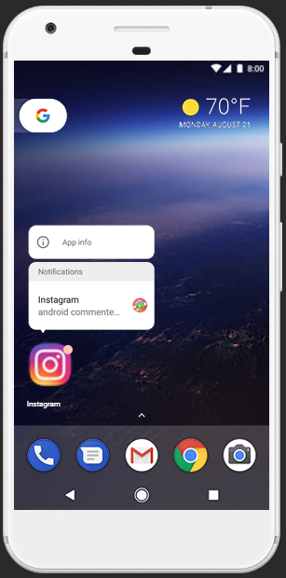
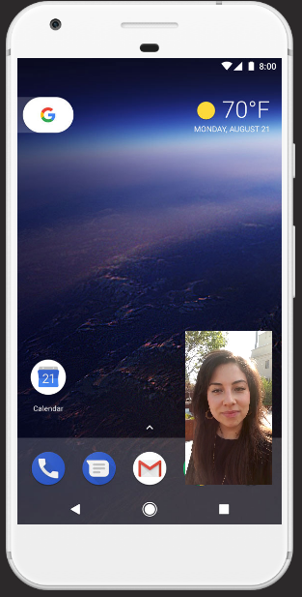
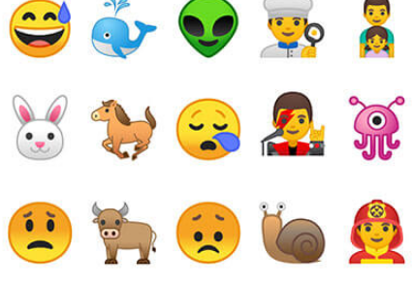
Features
New emoji Update
Quick notification
Multiple run application

Slide 48

Android P

Slide 49
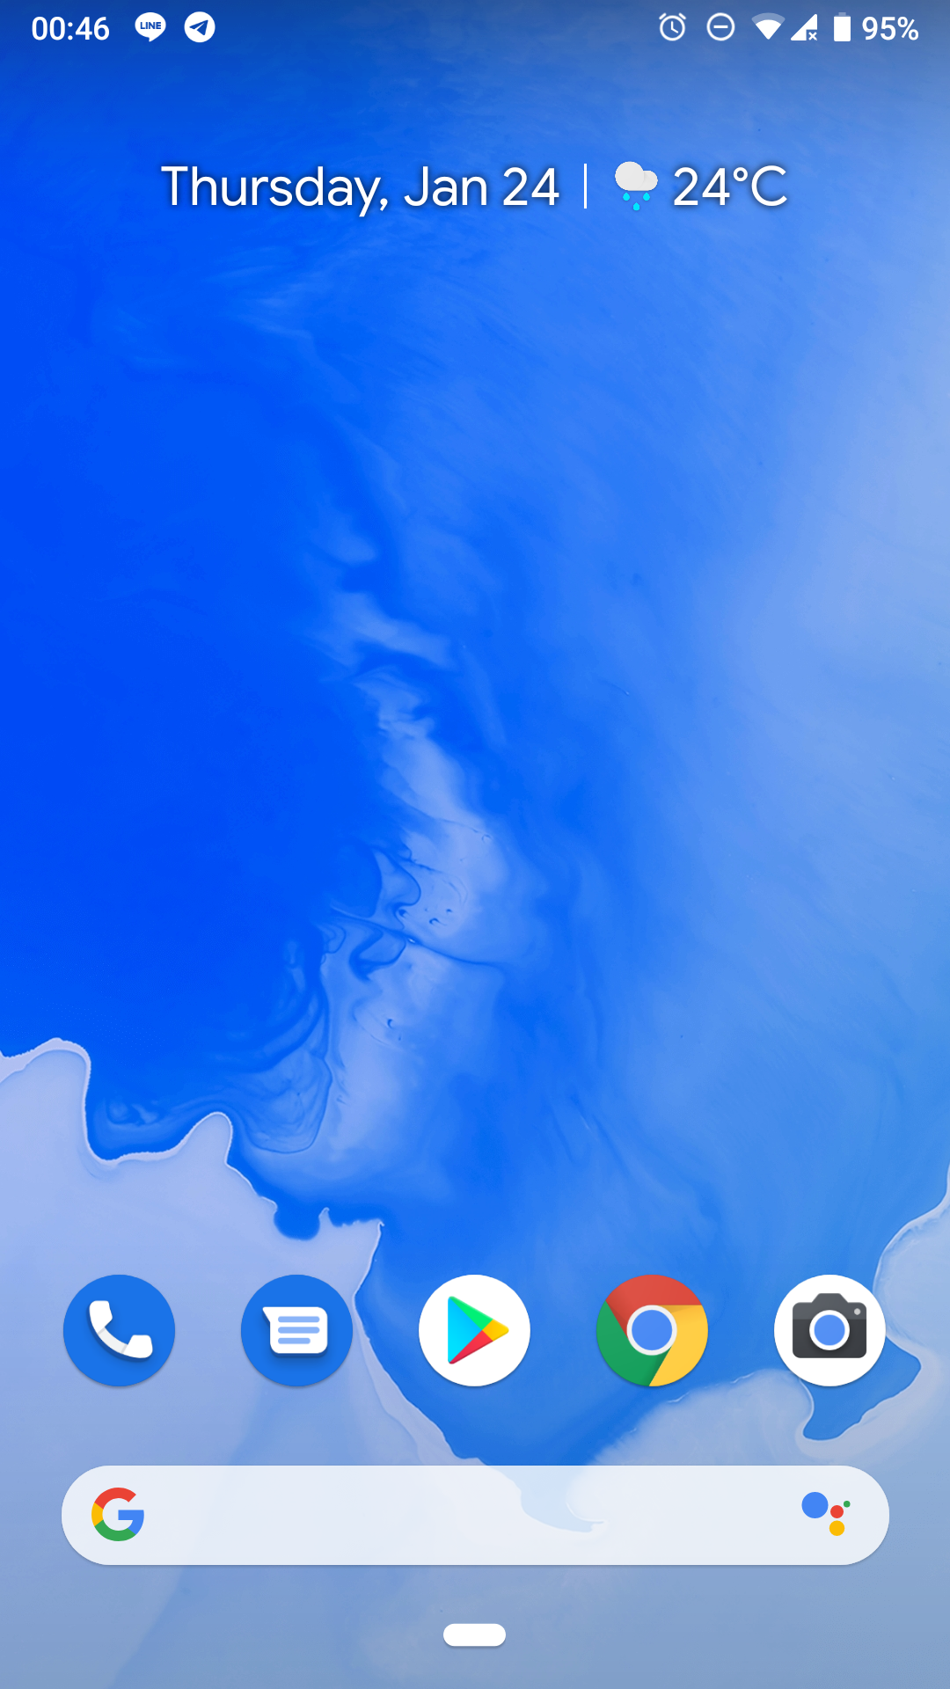
Android Oreo
Developer ;- Google
Released to ;- JULY 7,2021;
Version ;- (9.0.0_r70)

Slide 50
Android Q
Android O

Slide 51


Special Thanks
01
02
03
04
DARSHAN SIR PARMAR
SAKSHI CHOKWALA
DARSHAN SIR SINROJA
DHARMESH SIR SUCHAK
FACULTY
FACULTY
CENTER HEAD
MANGING DIRECTOR

Slide 52


T H A N K S F O R W A T C H I N G
SUCHAK E-LEARNING

